Slide 1
Consolidation and cyber-Security
When one goes out, they all go out

Slide 2

Please take my survey
Its only 12 questions!
Most are Yes/No!
Don’t think too in depth!
Mobile friendly!
Shameless plug over! Thank you!

Slide 3
About ME
Barman through University
Archaeologist
Sommelier and Wine Salesman
Sr. Application Analyst
Interdisciplinary Masters of Cybersecurity
currently

Slide 4
Modern Problem
Modern consolidation allows adversaries to disrupt operations with less effort than before, potentially causing widespread outages.
Example: If Big Finance Bank Inc. controls 50% of the financial services in a nation, a ransomware attack targeting them would lock up half of financial assets nationwide.
Single point of failure on an industrial scale
Very little literature on risk to critical infrastructure

Slide 5
16 Critical Infrastructure Sectors
Communications
Food and Agriculture
Healthcare (EPIC)
Financial Services (Chase, CitiGroup, Wells Fargo,
Nuclear Reactors (Rockwell)
And more!

Slide 6
Before digital age
Military depots decentralized
Not one single manufacturing facility
Difficult, almost impossible, to bomb every single ammunition factory
Decentralization offered unique form of protection

Slide 7
Modern Defense contractors
United States Military has blocked mergers
Centralization of defense contractors becomes a major risk
No longer have to bomb every plant, just need to hack the IT infrastructure
…a lack of competition reduces firms’ incentives to innovate and lower prices and can reduce the capacity and capabilities of DOD suppliers. Reducing the number of competitive suppliers can lead to weak supply chains prone to capacity shortfalls. There are particularly acute national security concerns in markets with only a small number of suppliers, especially where those suppliers are in adversarial nations. Ex. China and batteries…
Mclaughlin, M. (n.d.). National Security and Competition: How Courts Evaluate National Security When Assessing a Merger. Journal of National Security law and Policy, 14, 379-382 Retrieved March 9, 2025

Slide 8
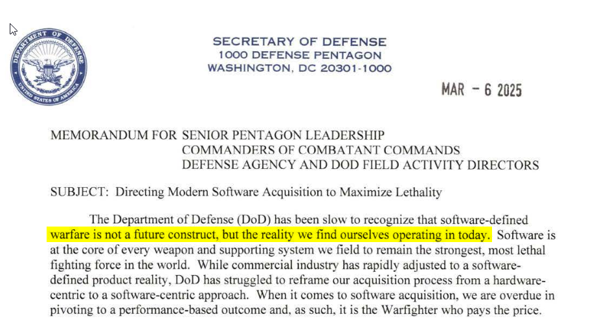
Some good news
https://media.defense.gov/2025/Mar/07/2003662943/-1/-1/1/DIRECTING-MODERN-SOFTWARE-ACQUISITION-TO-MAXIMIZE-LETHALITY.PDF

Slide 9
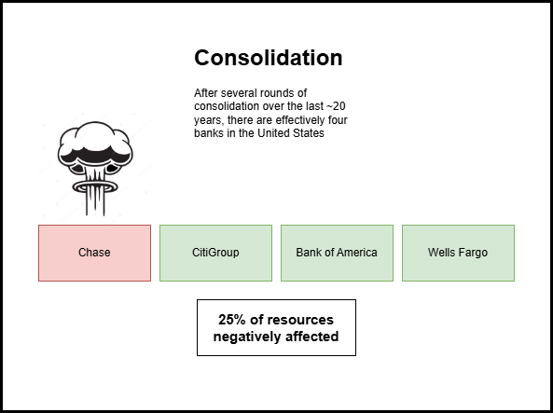
Scenario one

Slide 10
What do you do?
Don’t permit extreme consolidation to begin with?
Use anti-trust to break up companies? (Sherman/Clayton Act)
Require, by law, extreme segregation? By state? Region?
Separate Active Directory by state?
Any other ideas?

Slide 11
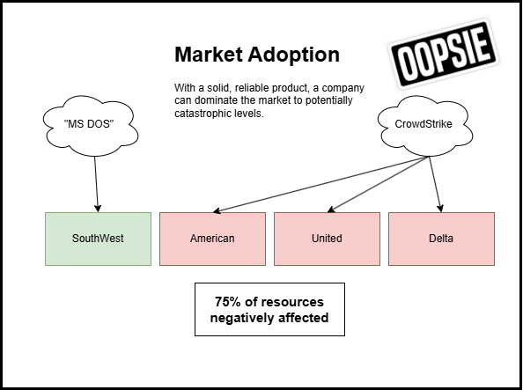
Scenario two

Slide 12
What do you do?
Limit how many companies can adopt?
Insurance?
Buy an alternative?
Require failover/backups by law?
Most likely up to us to ask the question ‘How is my organization protected from your outage?’

Slide 13

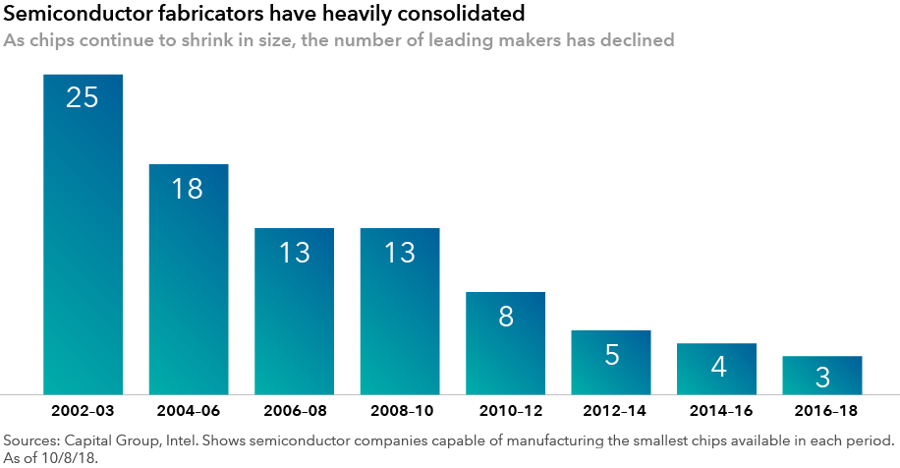
Semiconductor Fabricators Experienced Heavy Consolidation

Slide 14
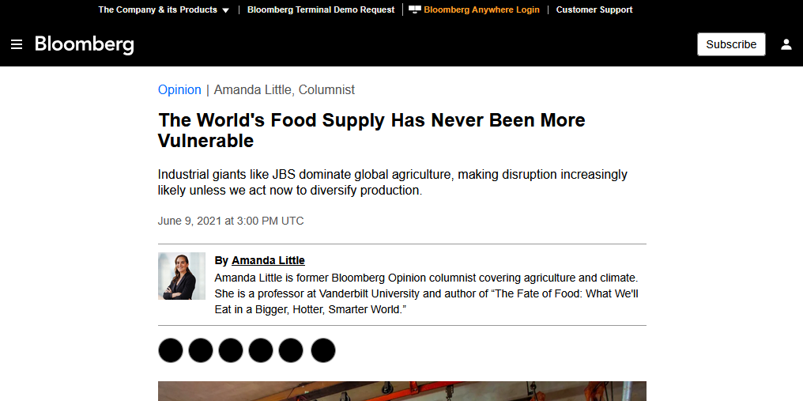
Everyone can Understand the Danger of Food Scarcity

